Slide 1
ISO27001:2013 Controls Appendix; Part 12
In this module lets look at ISO27001:2013 (ISMS) related to business continuity…

Slide 2

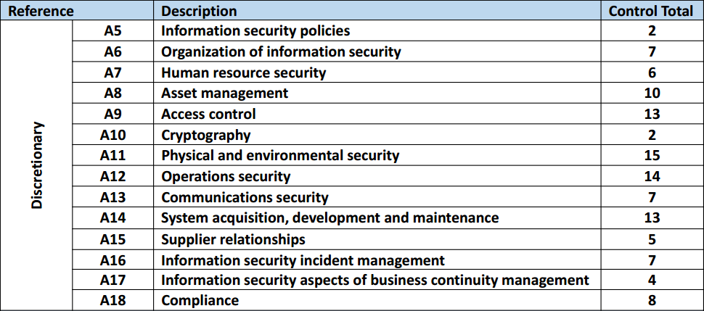
ISO27001:2013 Controls Appendix; Part 12
ISO27001:2013 DISCRETIONARY CONTROLS
TOTAL: 114
https://chapters.theiia.org/bermuda/Events/ChapterDocuments/Information%20Security%20Management%20System%20%28ISMS%29%20Overview.pdf

Slide 3
ISO27001:2013 Controls Appendix; Part 12
A.17 INFOSEC ASPECTS OF BUSINESS CONTINUITY MNGMT
A.17.1 INFORMATION SECURITY CONTINUITY
A.17.1.1 | PLANNING INFOSEC CONTINUITY
A.17.1.2 | IMPLEMENTING INFOSEC CONTINUITY
A.17.1.3 | VERIFY, REVIEW, & EVALUATE INFOSEC CONTINUITY

Slide 4
ISO27001:2013 Controls Appendix; Part 12
A.17 INFOSEC ASPECTS OF BUSINESS CONTINUITY MNGMT
A.17.1.1 | PLANNING INFOSEC CONTINUITY | Control: The organization shall determine its requirements for information security and the continuity of information security management in adverse situations, e.g. during a crisis or disaster.

Slide 5
ISO27001:2013 Controls Appendix; Part 12
A.17 INFOSEC ASPECTS OF BUSINESS CONTINUITY MNGMT
A.17.1.2 | IMPLEMENTING INFOSEC CONTINUITY | Control: The organization shall establish, document, implement and maintain processes, procedures and controls to ensure the required level of continuity for information security during an adverse situation.

Slide 6
ISO27001:2013 Controls Appendix; Part 12
A.17 INFOSEC ASPECTS OF BUSINESS CONTINUITY MNGMT
A.17.1.3 | VERIFY, REVIEW, & EVALUATE INFOSEC CONTINUITY | Control: The organization shall verify the established and implemented info security continuity controls at regular intervals in order to ensure that they are valid and effective during adverse situations.

Slide 7
ISO27001:2013 Controls Appendix; Part 12
A.17 INFOSEC ASPECTS OF BUSINESS CONTINUITY MNGMT
A.17.2 REDUNDANCIES
A.17.2.1 | AVAILABILITY OF INFORMATION PROCESSING FACILITIES
A.17.2.1 | AVAILABILITY OF INFORMATION PROCESSING FACILITIES | Control: Information processing facilities shall be implemented with redundancy sufficient to meet availability requirements.

Slide 8
ISO27001:2013 Controls Appendix; Part 12
Lets look at compliance in the next module…
END

